Slide 1

Using Problem-Oriented Discussion Cases to Develop Neuroscience Students’ Thinking Skills
Dan Johnson, Dept. Biology,
Wake Forest University
NTC 2023, July 20, 2023
Workshop Resources Site

Slide 2
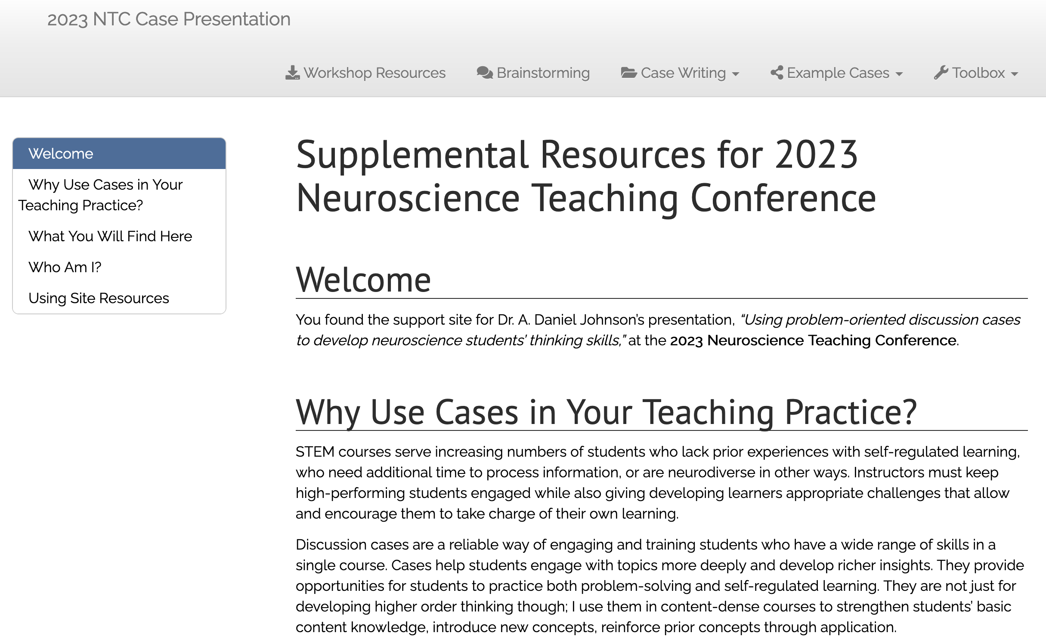
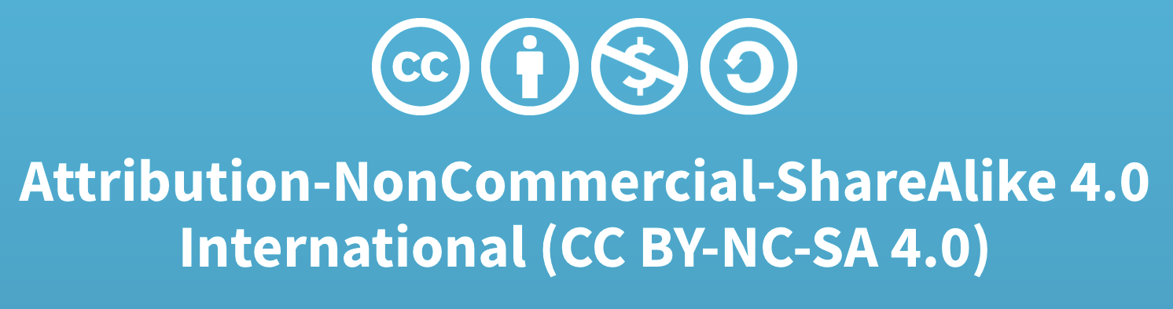
Companion Site: Cases & Writing Resources
Notes:
Direct URL: https://adanieljohnson.github.io/NTC2023/index.html

Slide 3
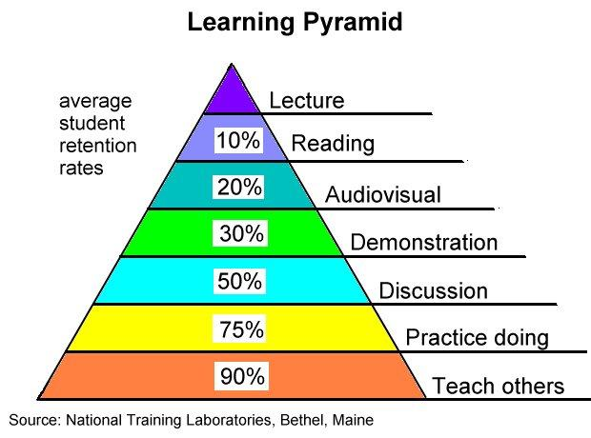
Why I Use Cases: The RETENTION Pyramid

Slide 4
Why I Use Cases: The RETENTION Pyramid

Slide 5
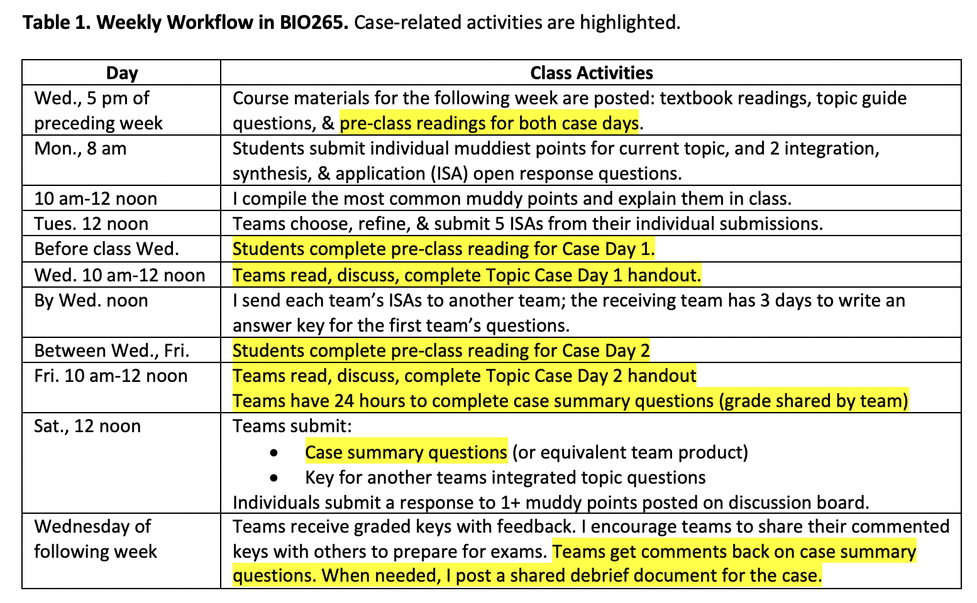
How I Use Cases: BIO265 Weekly Flow

Slide 6
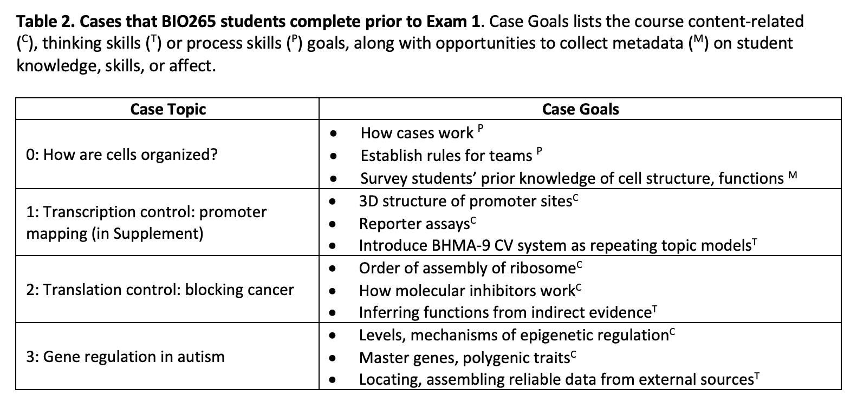
When I Use Cases: BIO265

Slide 7
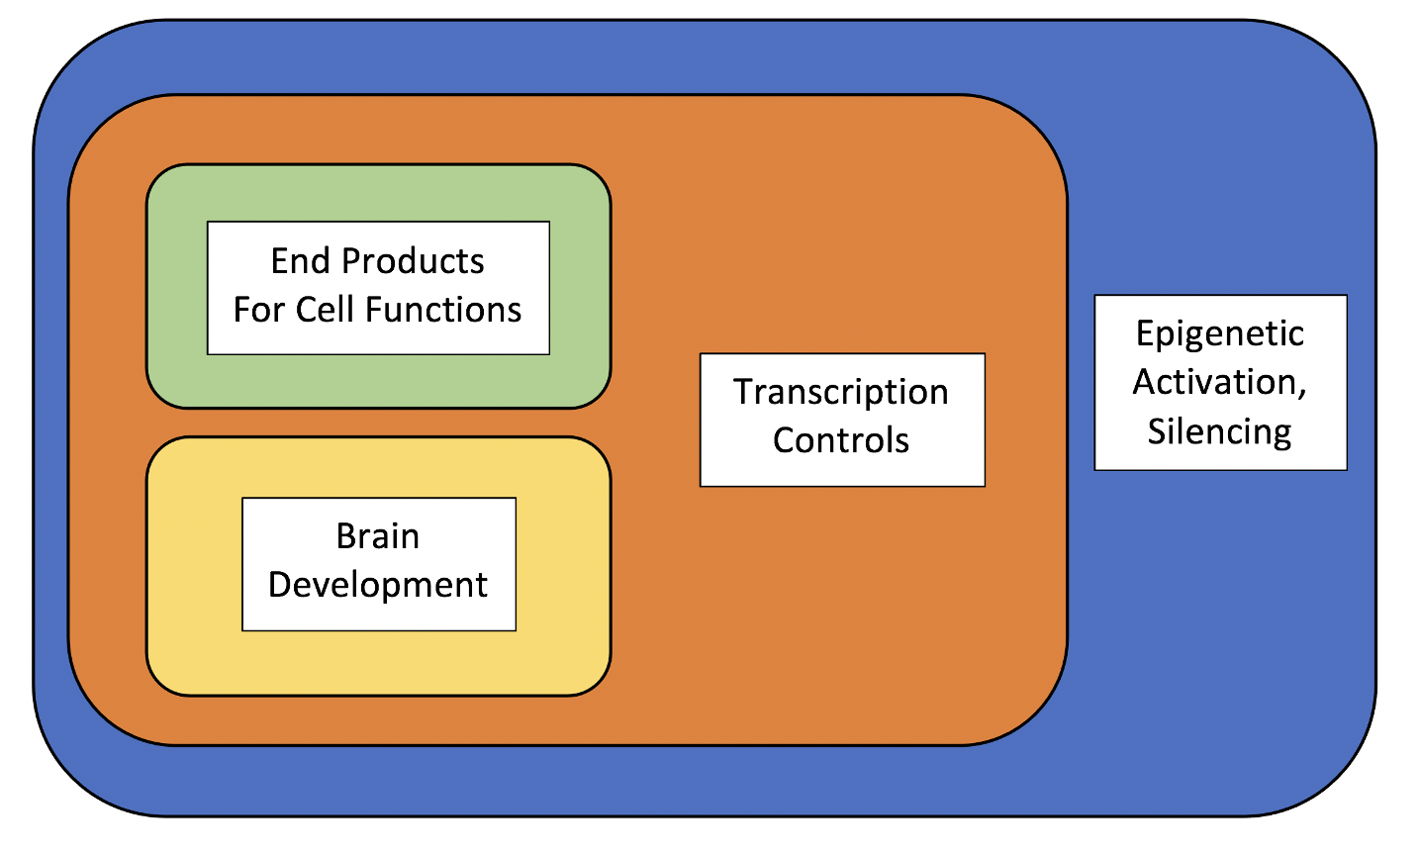
Sample Case: Genes of Autism (Wk. 3)
What students do not understand yet:
Simultaneous epigenetic regulation of multiple genes
How several paths can lead to a common phenotype
??
ASD
Phenotype
Diagram is given in DEBRIEF, not intro.

Slide 8
Case Elements
Background Reading
In-Class Handouts
Teams’ Goals In, After Class
Pre-class, on LMS
Orientation
OVERVIEW of activities
Links to ext. resources
Print copy of background
Datasets:
3-line o’views of 20 genes linked to ASD
Key 4 features of ASD
Day 1:
ID min. gene set
Draw interax. map
Day 2:
Present map, logic
Revise, reflect
Graded on:
REVISED map (team)
Reflection (individual)

Slide 9
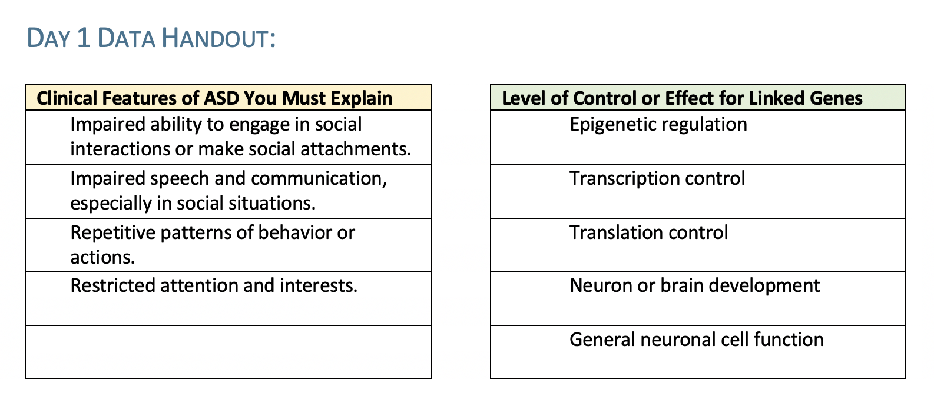
In-Class Datasets

Slide 10
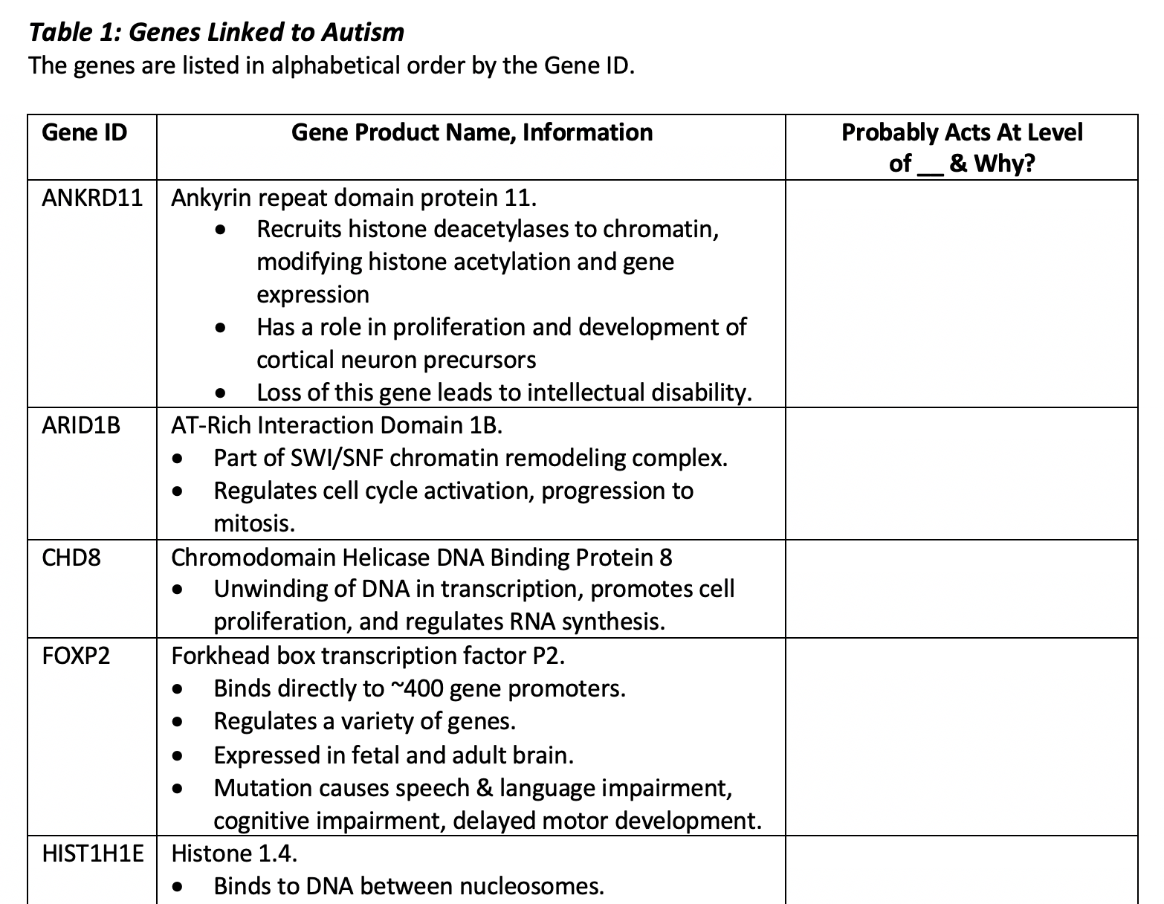
In-Class Datasets, cont.
Source: Wiśniowiecka-Kowalnik, 2019. Genetics and epigenetics of autism spectrum disorder—current evidence in the field. J. Appl. Genet. 60:37–47. doi: 10.1007/s13353-018-00480-w

Slide 11
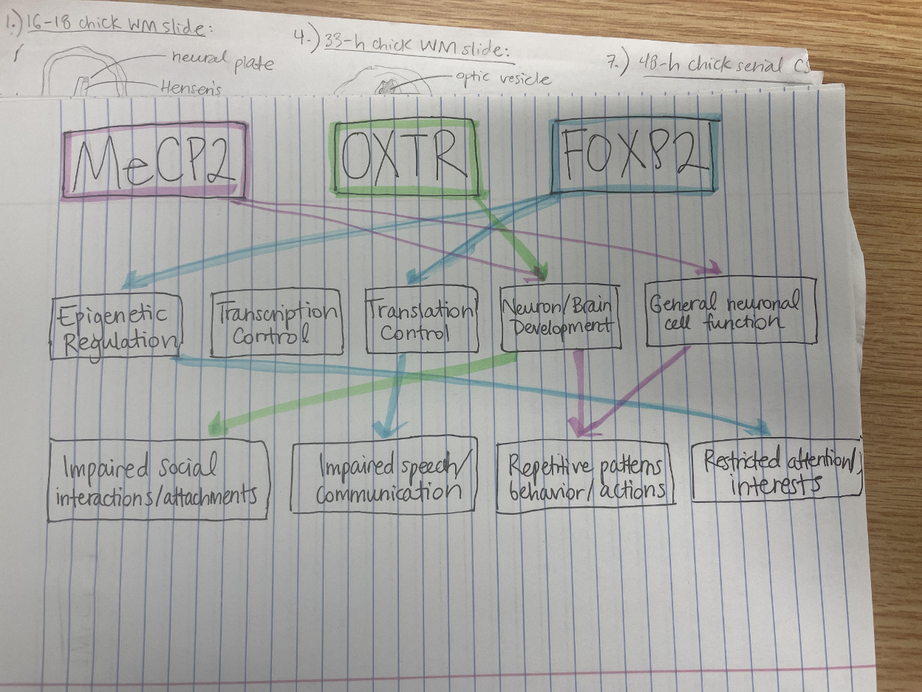
Sample Student Map #1

Slide 12
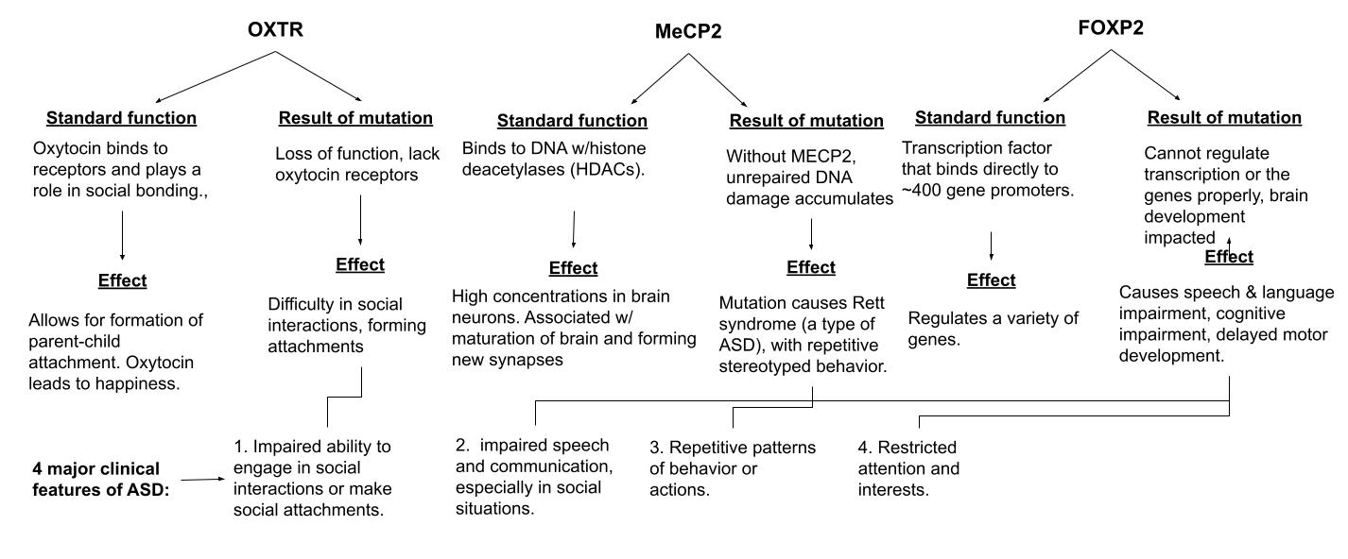
Sample Student Map #2

Slide 13
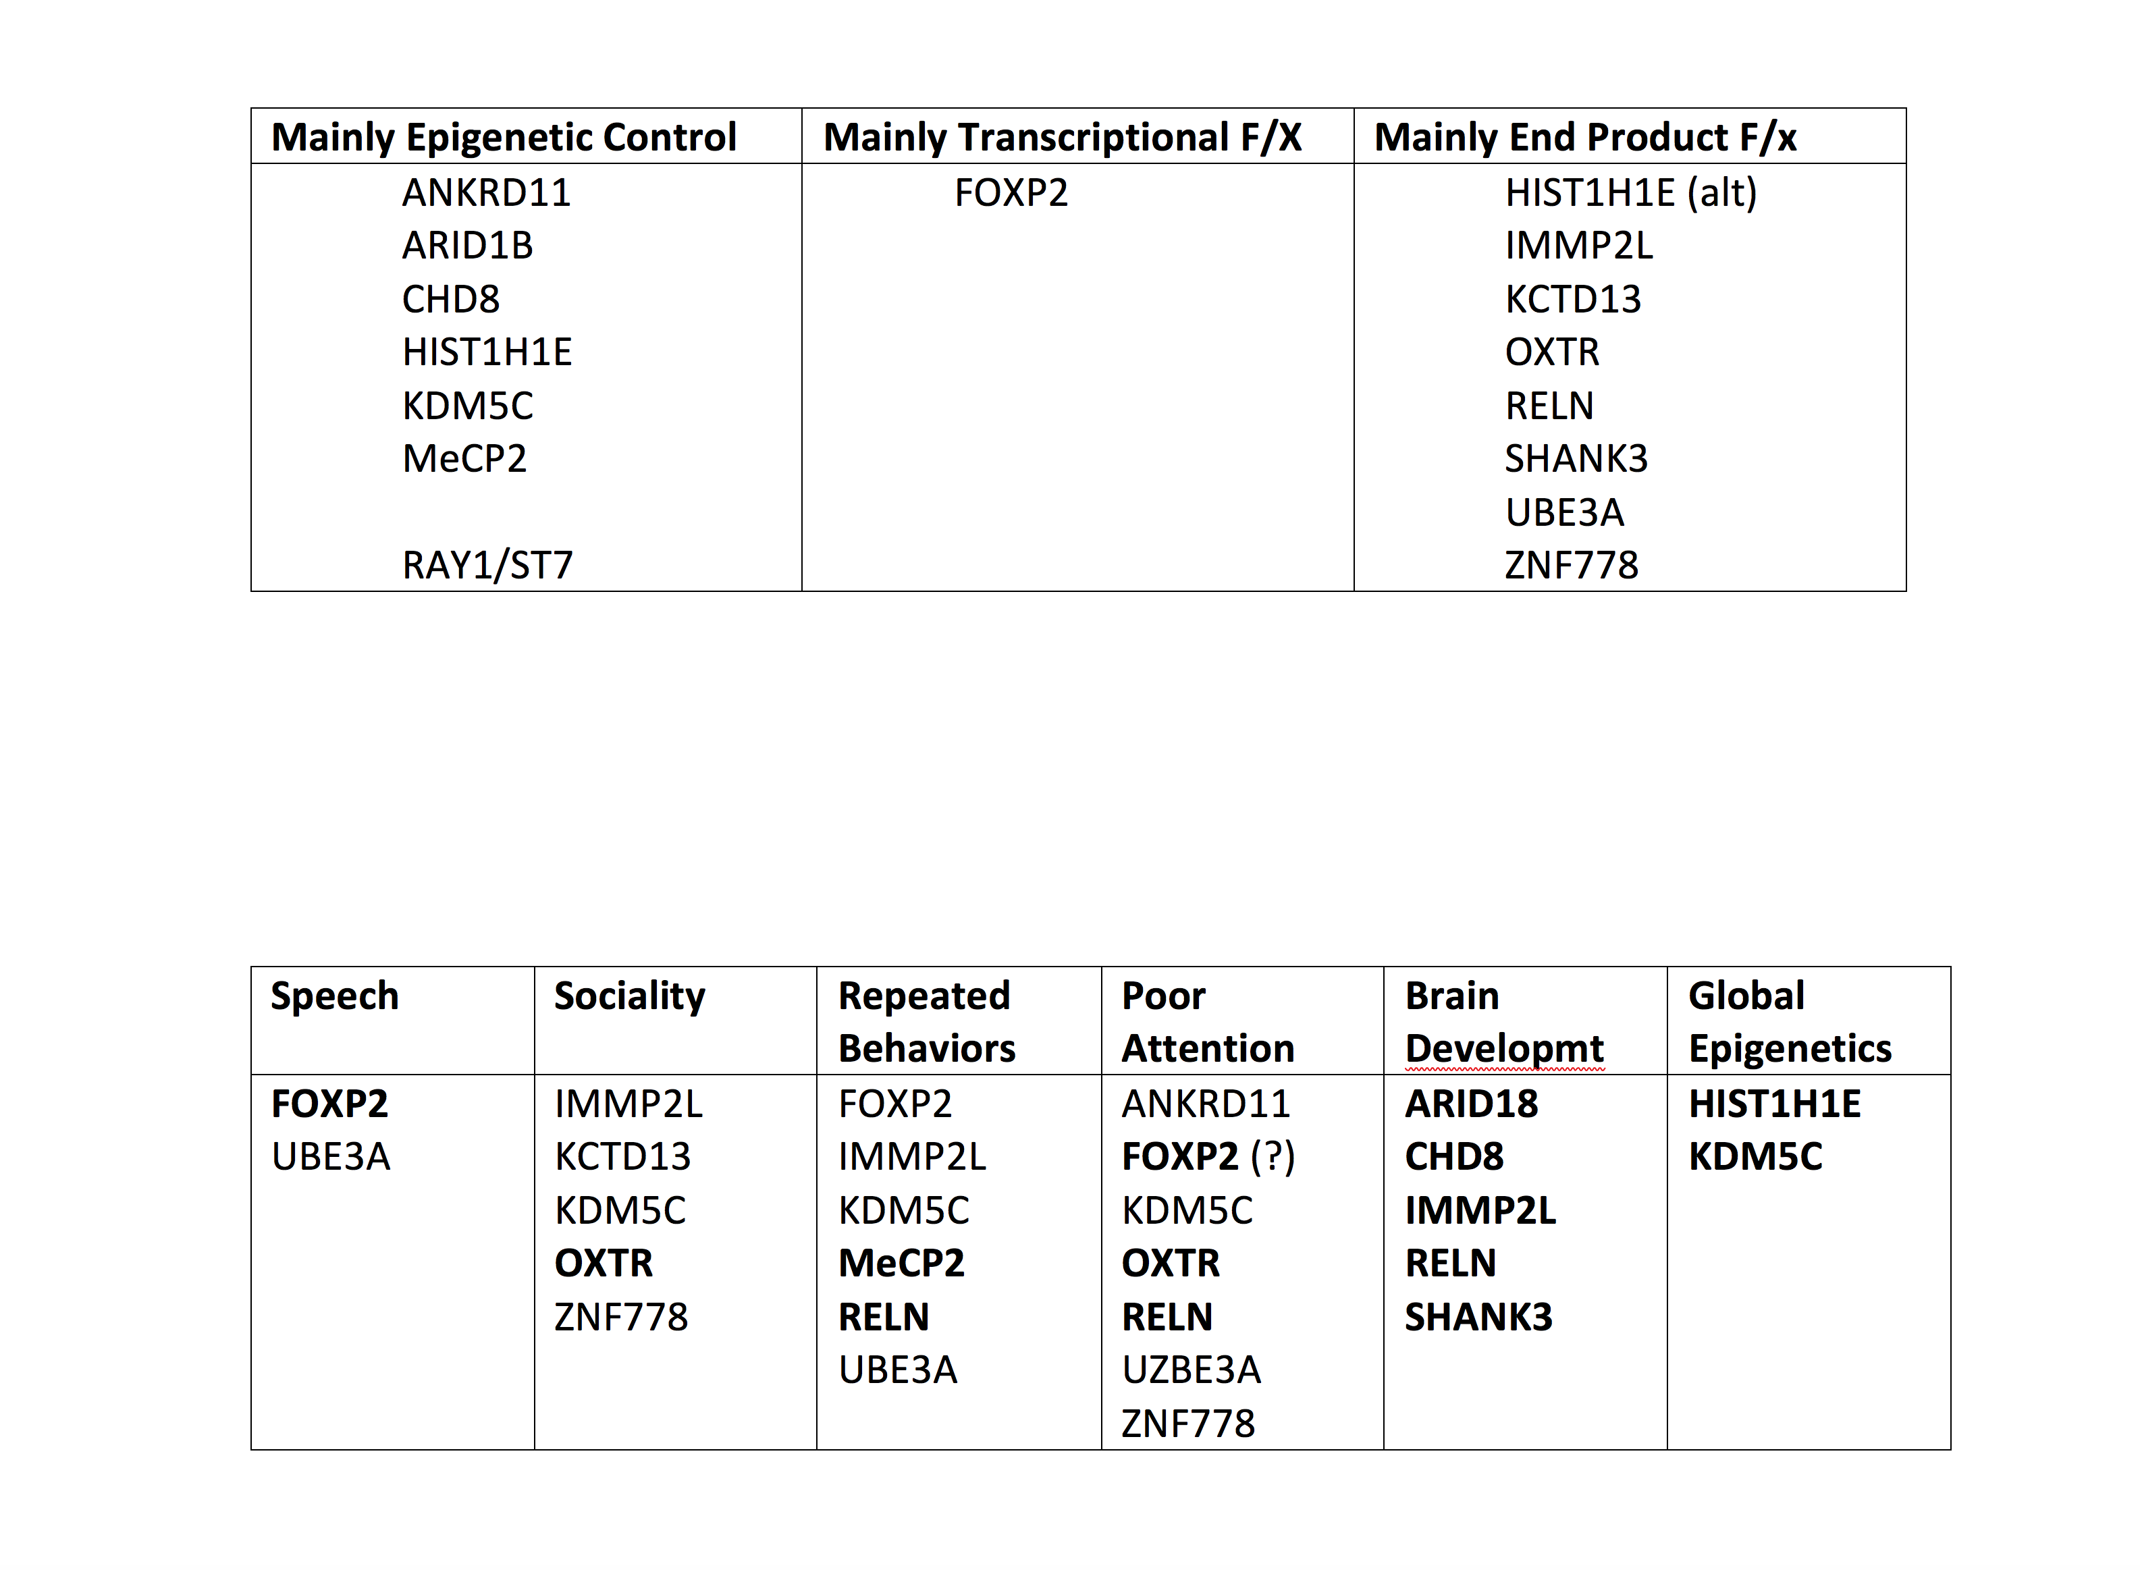
Reflection Incorporates Error Self-Correction

Slide 14
Looking Ahead/Continuing the Conversation
What are the “core” neuroscience topics, skills, thinking strategies for widely useful teaching cases?
What do you hope to accomplish or support with neuroscience teaching cases?
What case style(s), formats would be most useful?

Slide 15
What’s On the Resource Site?
Strategies, guides, and tools for case design, writing, implementation & evaluation
What else do YOU need to start writing, using cases?
Library of sample cases (shows different types)
Interest in a shared NS Cases archive?
Toolbox
What is missing?

